Slide 1

American Express
Customer Default Prediction
Team 12:
Nair, Bhagyashree - 002139969
Uddehal, Chandana - 002105599
Gawand, Pratik - 002102812
Hegde, Sathwik - 002194830

Slide 2
Introduction
We are using the American Express Default dataset from Kaggle: https://www.kaggle.com/competitions/amex-default-prediction/data
The objective of this project is to predict the probability that a customer does not pay back their credit card balance amount in the future based on their monthly customer profile.
In this dataset, there are 190 labels. It contains aggregated profile features for each customer: D_* = Delinquency variables, S_* = Spend variables, P_* = Payment variables, B_* = Balance variables, R_* = Risk variables
Our task is to predict, for each customer_ID, the probability of a future payment default, i.e., target= 1
Our dataset comprises of 3 csv files:
train_data: Training dataset: 200000 records
train_labels: Prediction outcome labels for the training dataset: 200000 records
test_data: Testing dataset: 200000 records

Slide 3
Methodology
We perform data preprocessing on this dataset, by doing Transformation, Feature Engineering and Data Imputation methods.
We do Exploratory Data Analysis on customer profile features:
Distribution analysis of Delinquency Variables, Spend variables, Payment variables, Balance variables, Risk variables
Correlation of the independent features with the target
Dimension Reduction using Principal Component Analysis
4 data models implemented on the dataset:
1) Logistic regression, 2) XGBoost, 3) RandomForestClassifier, 4) Support Vector Machine
Hyperparameter Tuning for 1) XGBoost Classifier- GridSearch, 2) XGBoost with RandomizedSearchCV, 3) XGBoost with BayesSearchCV, 4) RandomForestClassifier using GridSearchCV
We provide a summarised accuracy visualization to help determine the best algorithm for our data

Slide 4
Data Preprocessing
Data Cleaning:
Removal of redundant columns such as transaction date
Null value handling
Data imputation using Mean, Median and Mode done to analyse the effect of each imputation method
Data Processing:
Feature Distribution
Time series analysis of customer transactions over a year
Distribution and Correlation of the different customer profile variables
Correlation of all independent features with the target output
Correlation matrix - PCA

Slide 5
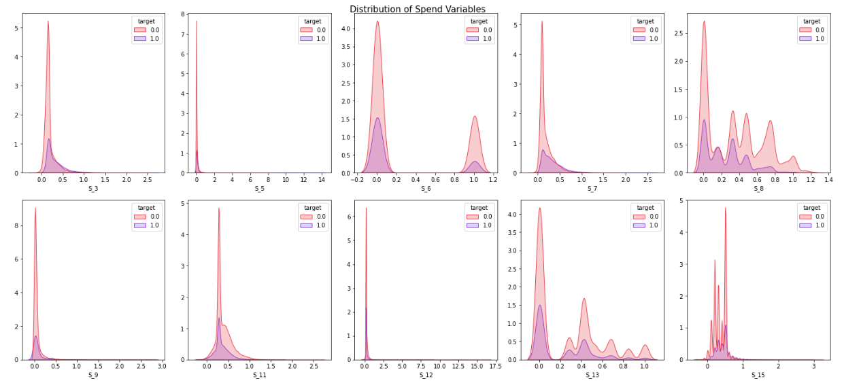
Data Visualization
Distribution Analysis of Spend variables-
Remark: Most of the variables showed a skewed distribution

Slide 6
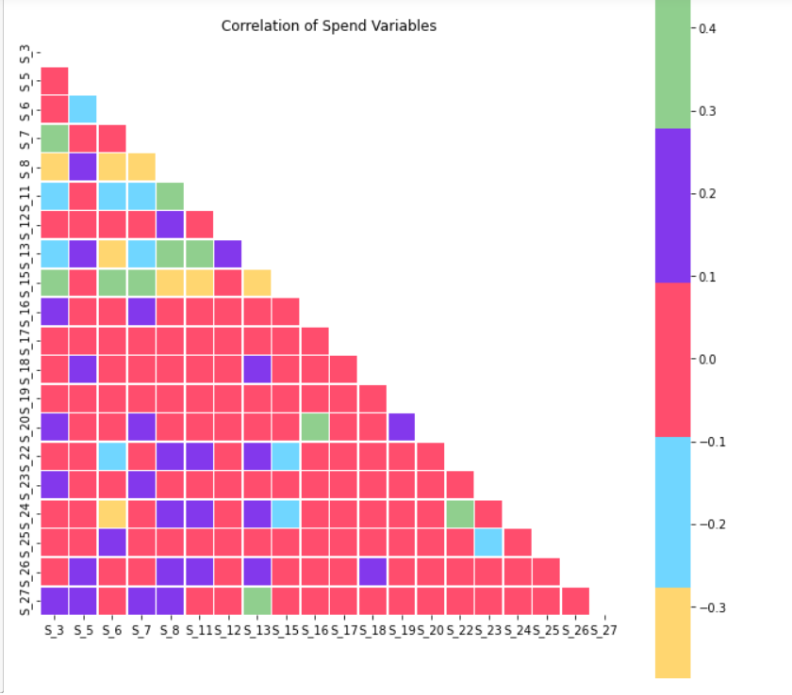
Data Visualization
Correlation of spend variables-
Very few spend variables are positively correlated to each other

Slide 7
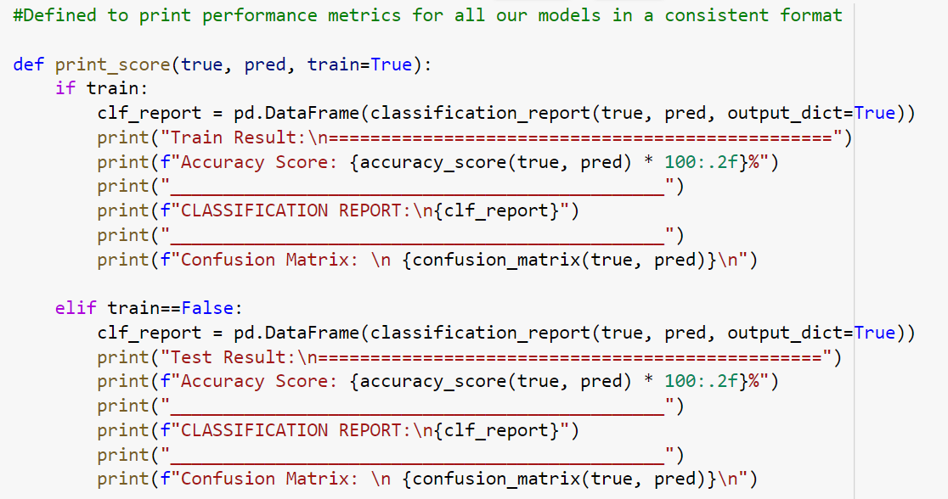
Model Evaluation
Model Performance Evaluation Function:

Slide 8
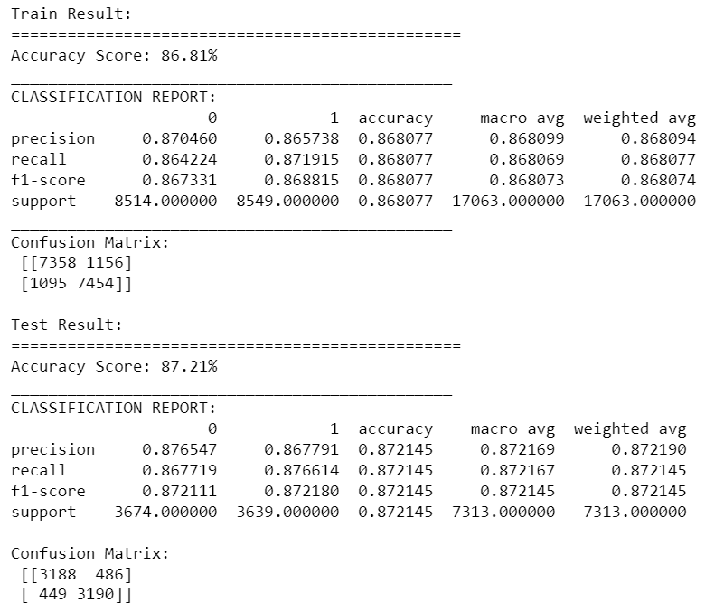
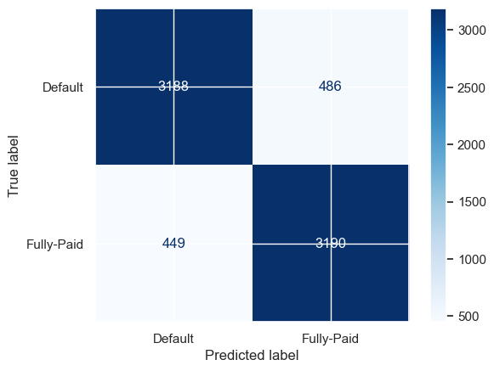
Model 1: Logistic Regression Model

Slide 9
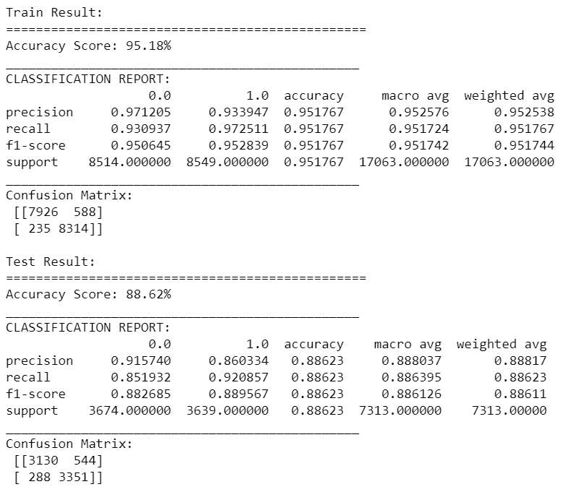
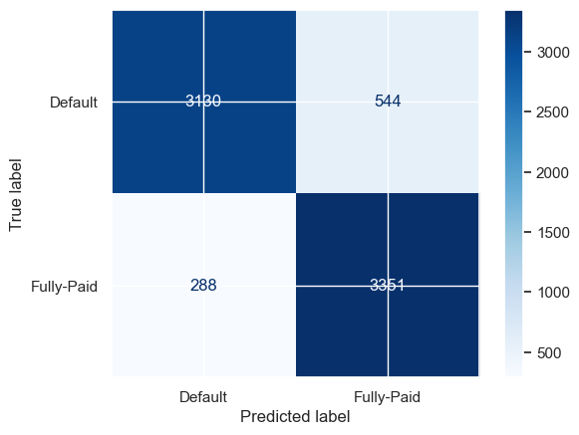
Model 2: XGBoost (No hyper parameter tuning)

Slide 10
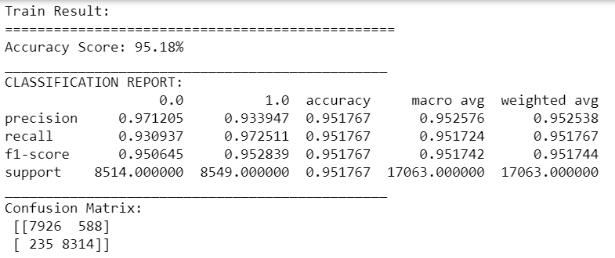
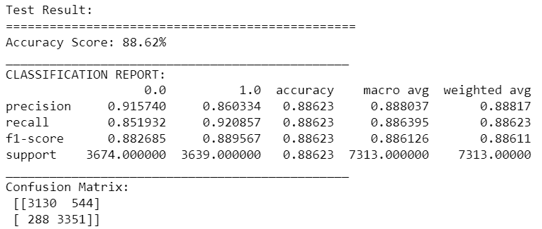
Model 2: XGBoost (Hyper parameter tuning- GridSearchCV)

Slide 11
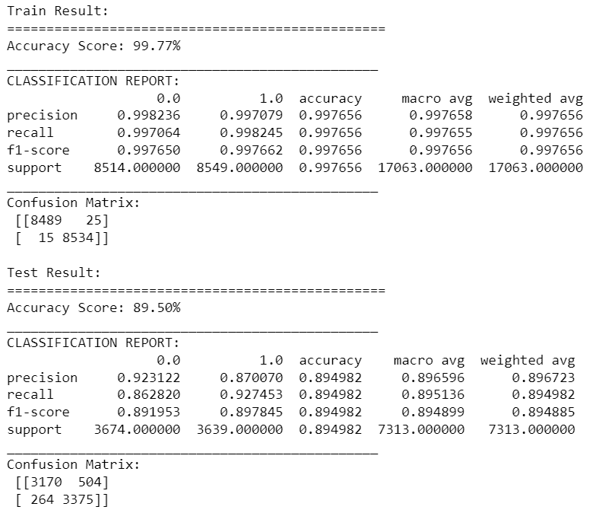

Model 2: XGBoost (Hyper parameter tuning- RandomizedSearchCV)

Slide 12
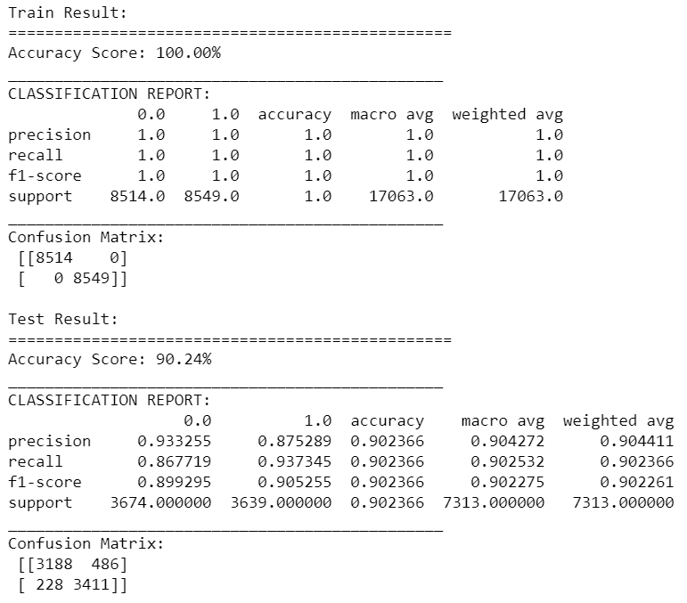
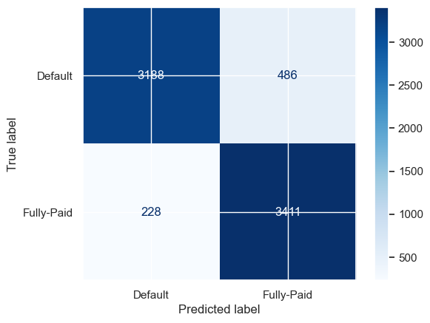
Model 2: XGBoost (Hyper parameter tuning- BayesSearchCV)

Slide 13
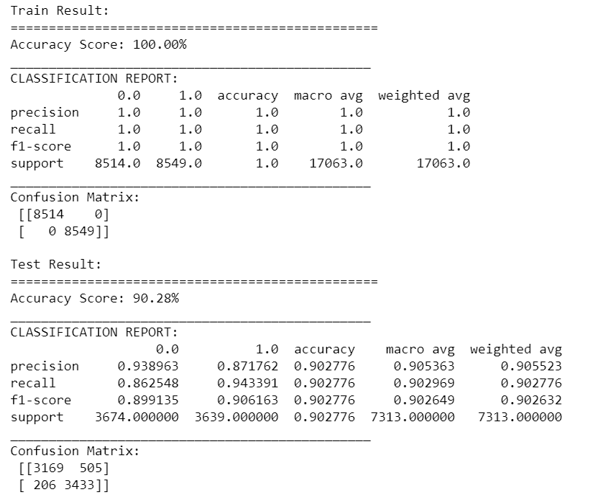

Model 3: Random Forest Classifier (No hyper parameter tuning)

Slide 14
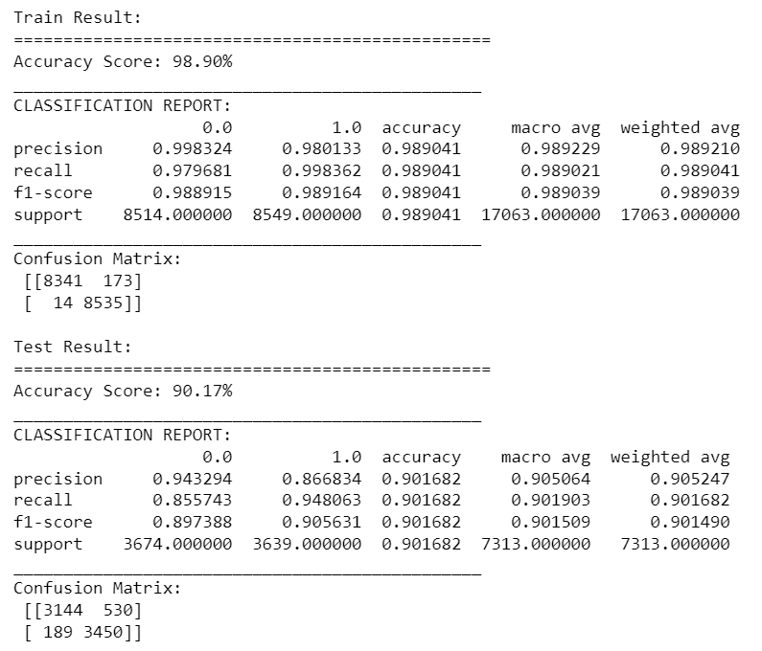

Model 3: Random Forest Classifier (Hyper parameter tuning- GridSearchCV)

Slide 15
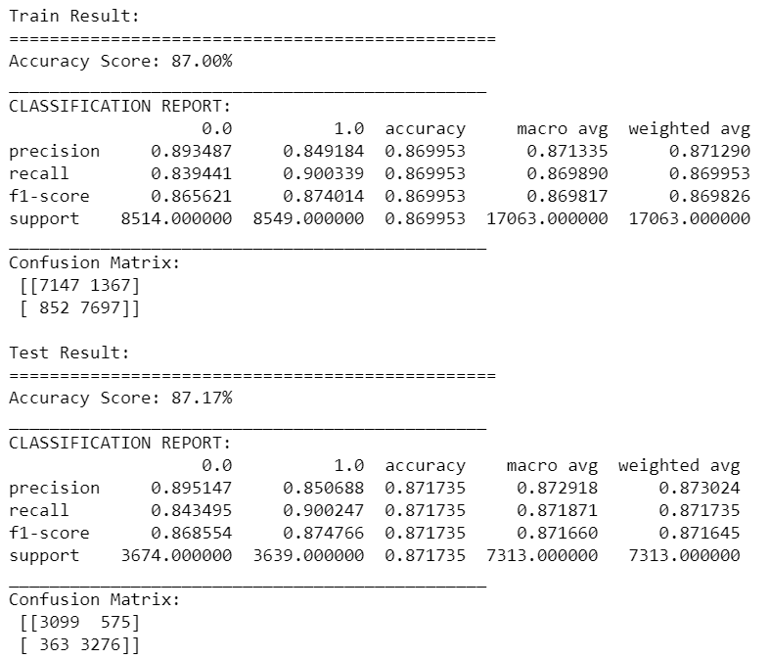

Model 3: Support Vector (No hyper parameter tuning)

Slide 16
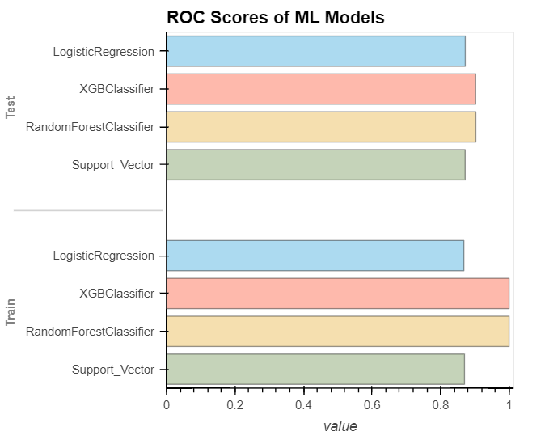
Summarised Model Evaluation

Slide 17
Results
Model | Accuracy | Accuracy after Hyperparameter Tuning
Logistic Regression | 87.21% | 87.21%
XGBoost Classifier | 88.62% | 88.62% (Grid Search) 89.25% (Random Search) 90.02% (Bayes Search)
Random Forest Classifier | 90.46% | 90.25%
Support Vector | 86.44% | 86.44%

Slide 18
Conclusion
1) Logistic Regression, after hyperparameter tuning, gave an accuracy of 87.21%
2) XGBoost gave an accuracy of 88.62%
After hyperparameter tuning:-
1) GridSearch: 88.62%
2) RandomizedSearch: 89.25%
3) BayesSearch: 90.02%
3) RandomForestClassifier gave an accuracy of 90.46%
After hyperparameter tuning:
GridSearch: 90.25%
This was the only case to record a lower accuracy (0.2%) after hyper parameter tuning
4) Support Vector after hyperparameter tuning, gave an accuracy of 86.44%
After a comparative study on the models above, we come to a conclusion that the classification model
using RandomForestClassifier is the best model with an accuracy score of 90.46% without and 90.25%
with Hyperparameter Tuning.

Slide 19
Thank you!
.

